Slide 1
Formal Meeting
Communication Skills

Slide 2
Important Questions to be answered
What is a formal meeting?
What is the purpose of a formal meeting?
Formal meeting vs. informal meetings
Different types of formal meetings
What do you need for a formal meeting?
Formal meeting agenda template
Tips on how to run a formal meeting

Slide 3
What is Formal Meeting
A formal meeting is a pre-planned gathering of two or more people who have assembled for the purpose of achieving a common goal through verbal interaction.
A formal meeting is what you likely think of first. There's a set agenda and a strict protocol. One person typically leads the discussion. There might be rules on who can speak when and for how long.

Slide 4
Examples of Formal Meeting
Management Meeting. Perhaps the most frequently-held formal meetings are management meetings. ...
Board of Directors meeting. ...
Committee meeting. ...
Shareholders' meeting. ...
Strategy meeting.

Slide 5
The Purpose of Formal Meeting
The purpose of a formal meeting is to discuss the list of predetermined topics and address the set of objectives, and make decisions relating to them.
Developing ideas
Planning
Solving problem
Making decisions
Creating and developing understanding
Providing sense of directions
Creating a common purpose

Slide 6
What terms are used in managing formal meetings?
Agenda – An agenda sets out the structure of the meeting. Minutes – Minutes are a formal record of the events which occur during a meeting.
Motion – A motion is a proposal or a suggestion within a meeting. Chairperson – The chairperson is in charge of the meeting and decides who can speak and when.
Order – If more than one person is speaking at once, or if the meeting is becoming an argument, rather than a discussion, the chair may call “order”.
Quorum – This refers to the minimum number of people required for the meeting to remain valid.

Slide 7
Formal vs Informal Meeting
In a formal meeting, there’s a set agenda and a strict protocol. One person typically leads the discussion. There might be rules on who can speak when and for how long. Often a notetaker records minutes, which follow a specific structure and use more formal language.
An informal meeting may not look like a traditional meeting at all. It is typically much looser or more flexible. Rather than a conference room or video-conferencing call, it might take place in a break room, an office or even a local bar or restaurant. There are few specific protocols, though the group might agree to certain conventions such as voice votes.

Slide 8
Formal vs Informal meeting
In a formal meeting, time is usually broken into blocks, with the schedule distributed in advance. For example, the main speakers might talk for 30 minutes each, followed by small-group breakout sessions, with everyone reconvening to discuss the results.
An informal meeting might have a loose plan, but participants typically feel freer to go “off script.” People can generally interject whenever they want, and brainstorming is common. Informal meetings usually happen within a specific time block but might run longer or shorter depending on how things develop.

Slide 9
……
Examples of Formal meetings include, but are not limited to:
Board meetings
Team or departmental meetings
Quarterly reviews
Committee meetings
Governmental debates
Examples of Informal meetings include, but are not limited to:
Training sessions
Problem-solving meetings
Post–formal meeting discussions
Talks on upcoming changes

Slide 10
Types of Formal Meetings 1. Management meetings
Perhaps the most frequently-held formal meetings are management meetings.
Happening at different intervals, but are usually either monthly or quarterly.
In these meetings, the meeting agenda will usually include an update from each department on performance, an evaluation against annual goals and targets, and votes on key decisions, such as the implementation of new software or the hiring of a new member of the leadership team.
Minutes for these meetings are recorded, and in some cases are distributed.

Slide 11
Board of Directors meeting
A company's Board of Directors is accountable to shareholders, and is responsible for having oversight of a company's performance.
Held at different intervals, but are typically quarterly or bi-annual meetings.
These meetings need to be well-organised and very structured, giving ample time for individuals to prepare thoroughly.

Slide 12
Committees meeting
In many organisations, committees are formed around specific issues that require more attention that can be adequately given in a Board of Directors meeting.
These committees will meet more regularly than the board does, and will report upon their progress at each BoD meeting.
They usually comprise members of the board, along with subject-matter experts in the area that they are formed to work upon.
For example, a Board of Directors might assemble a specialist committee around digital transformation, in order to overhaul an organisation's approach to IT and its infrastructure.

Slide 13
Shareholder Meeting
A shareholder's meeting, also known as an annual general meeting (AGM) in some cases, is a meeting of all of those with a financial interest in an organisation.
These usually happen either annually or bi-annually, and are an opportunity for the leadership of a company to give a progress update, as well as a chance for shareholders to ask questions of the management.
The overall objective is to report on the performance of the organisation in the prior period, and to outline the strategy for the next, to gain the shareholders' buy-in.

Slide 14
Strategy Meeting
Strategy meetings can be held at various levels within the management of an organisation.
In some cases, a strategy meeting might form part of a regular management meeting, however it is, more often, a separate formal meeting that is held either annually or quarterly between the leaders of an organisation.
The purpose of this meeting is to determine the organisational strategy for a period of time (often the year or quarter ahead) and involves the most senior stakeholders from each department or division, who then cascade the strategy down to their areas of expertise.

Slide 15
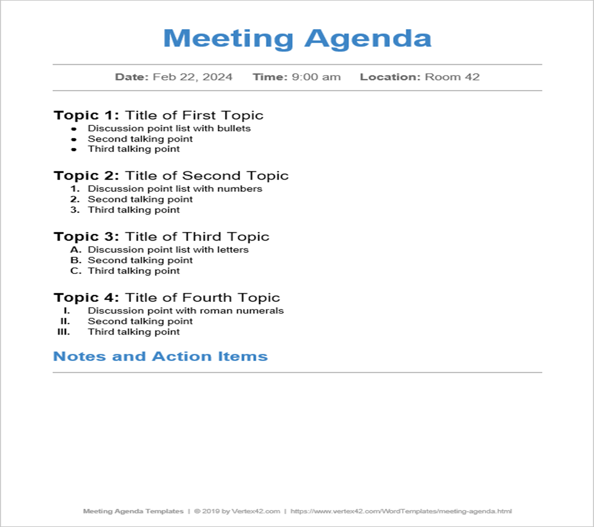
Meeting Agenda Template

Slide 16
Tips for running Formal Meeting
With a formal meeting template in hand and a good knowledge of what formal meetings comprise, you’re almost ready to get started. Before that, below are a few extra tips to help make your formal meeting a smashing success.
Set clear objectives
Assemble the right attendees
Create a solid agenda
Maintain control
Follow up

